Slide 1
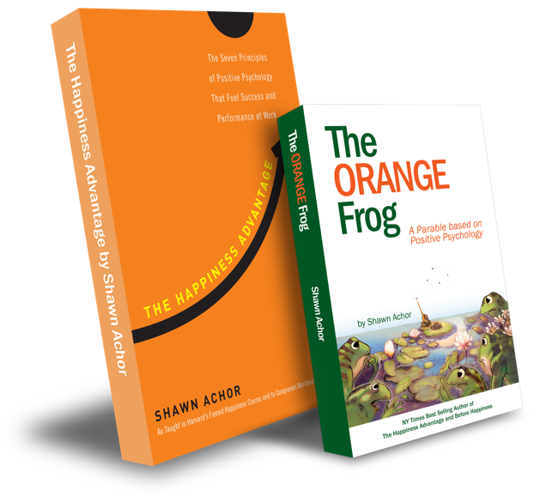
The Happiness Advantage
and
The Orange Frog
By Shawn Achor

Slide 2
High School Week Four

Slide 3
The Orange Frog
Learning Objective:
I can reframe my thinking to create a “SPARK-like” self identity
I will discuss the importance of making choices that show the person I want to be perceived as
Notes:
Standard:
Essential Concept and/or Skill: Communicate and work productively with others emphasizing collaboration and cultural awareness to produce quality work.
Interact positively as a team member.
Cooperate with others in a group setting.
Generate ideas with group members.
Are active listeners.
Read and understand information in a variety of forms.
Express ideas.
Skill:
Active listening, express ideas
Allow Spark to read pages 13-18 for the students or read to them.
https://www.orangefrogschools.com/elementary/ofkidsbook

Slide 4
Skills
Interact positively as a team member.
Cooperate with others in a group setting.
Generate ideas with group members.
Are active listeners.
Read and understand information in a variety of forms.
Express ideas.

Slide 5
Opening Question
What do you remember about the story we read last week?

Slide 6
A Word From Shawn

Slide 7
Thoughts
In Chapter 7, the frogs moved to Pond 4 and desired to replicate what makes others Orange. Misty felt nervous upon overhearing other frogs talking. The looming storm was accompanied by an imminent danger - The Herons, who fortunately decided not to harm the frogs.
This event pushed the frogs in the right direction, and they started working together for each other, creating an Orange environment and bountiful opportunities. Misty's famous line was, 'Just because we’re Orange, doesn’t mean we don’t see the problems, it means we know we can do something about it.' Ultimately, the frogs developed the best plan to survive the Deluge."

Slide 8
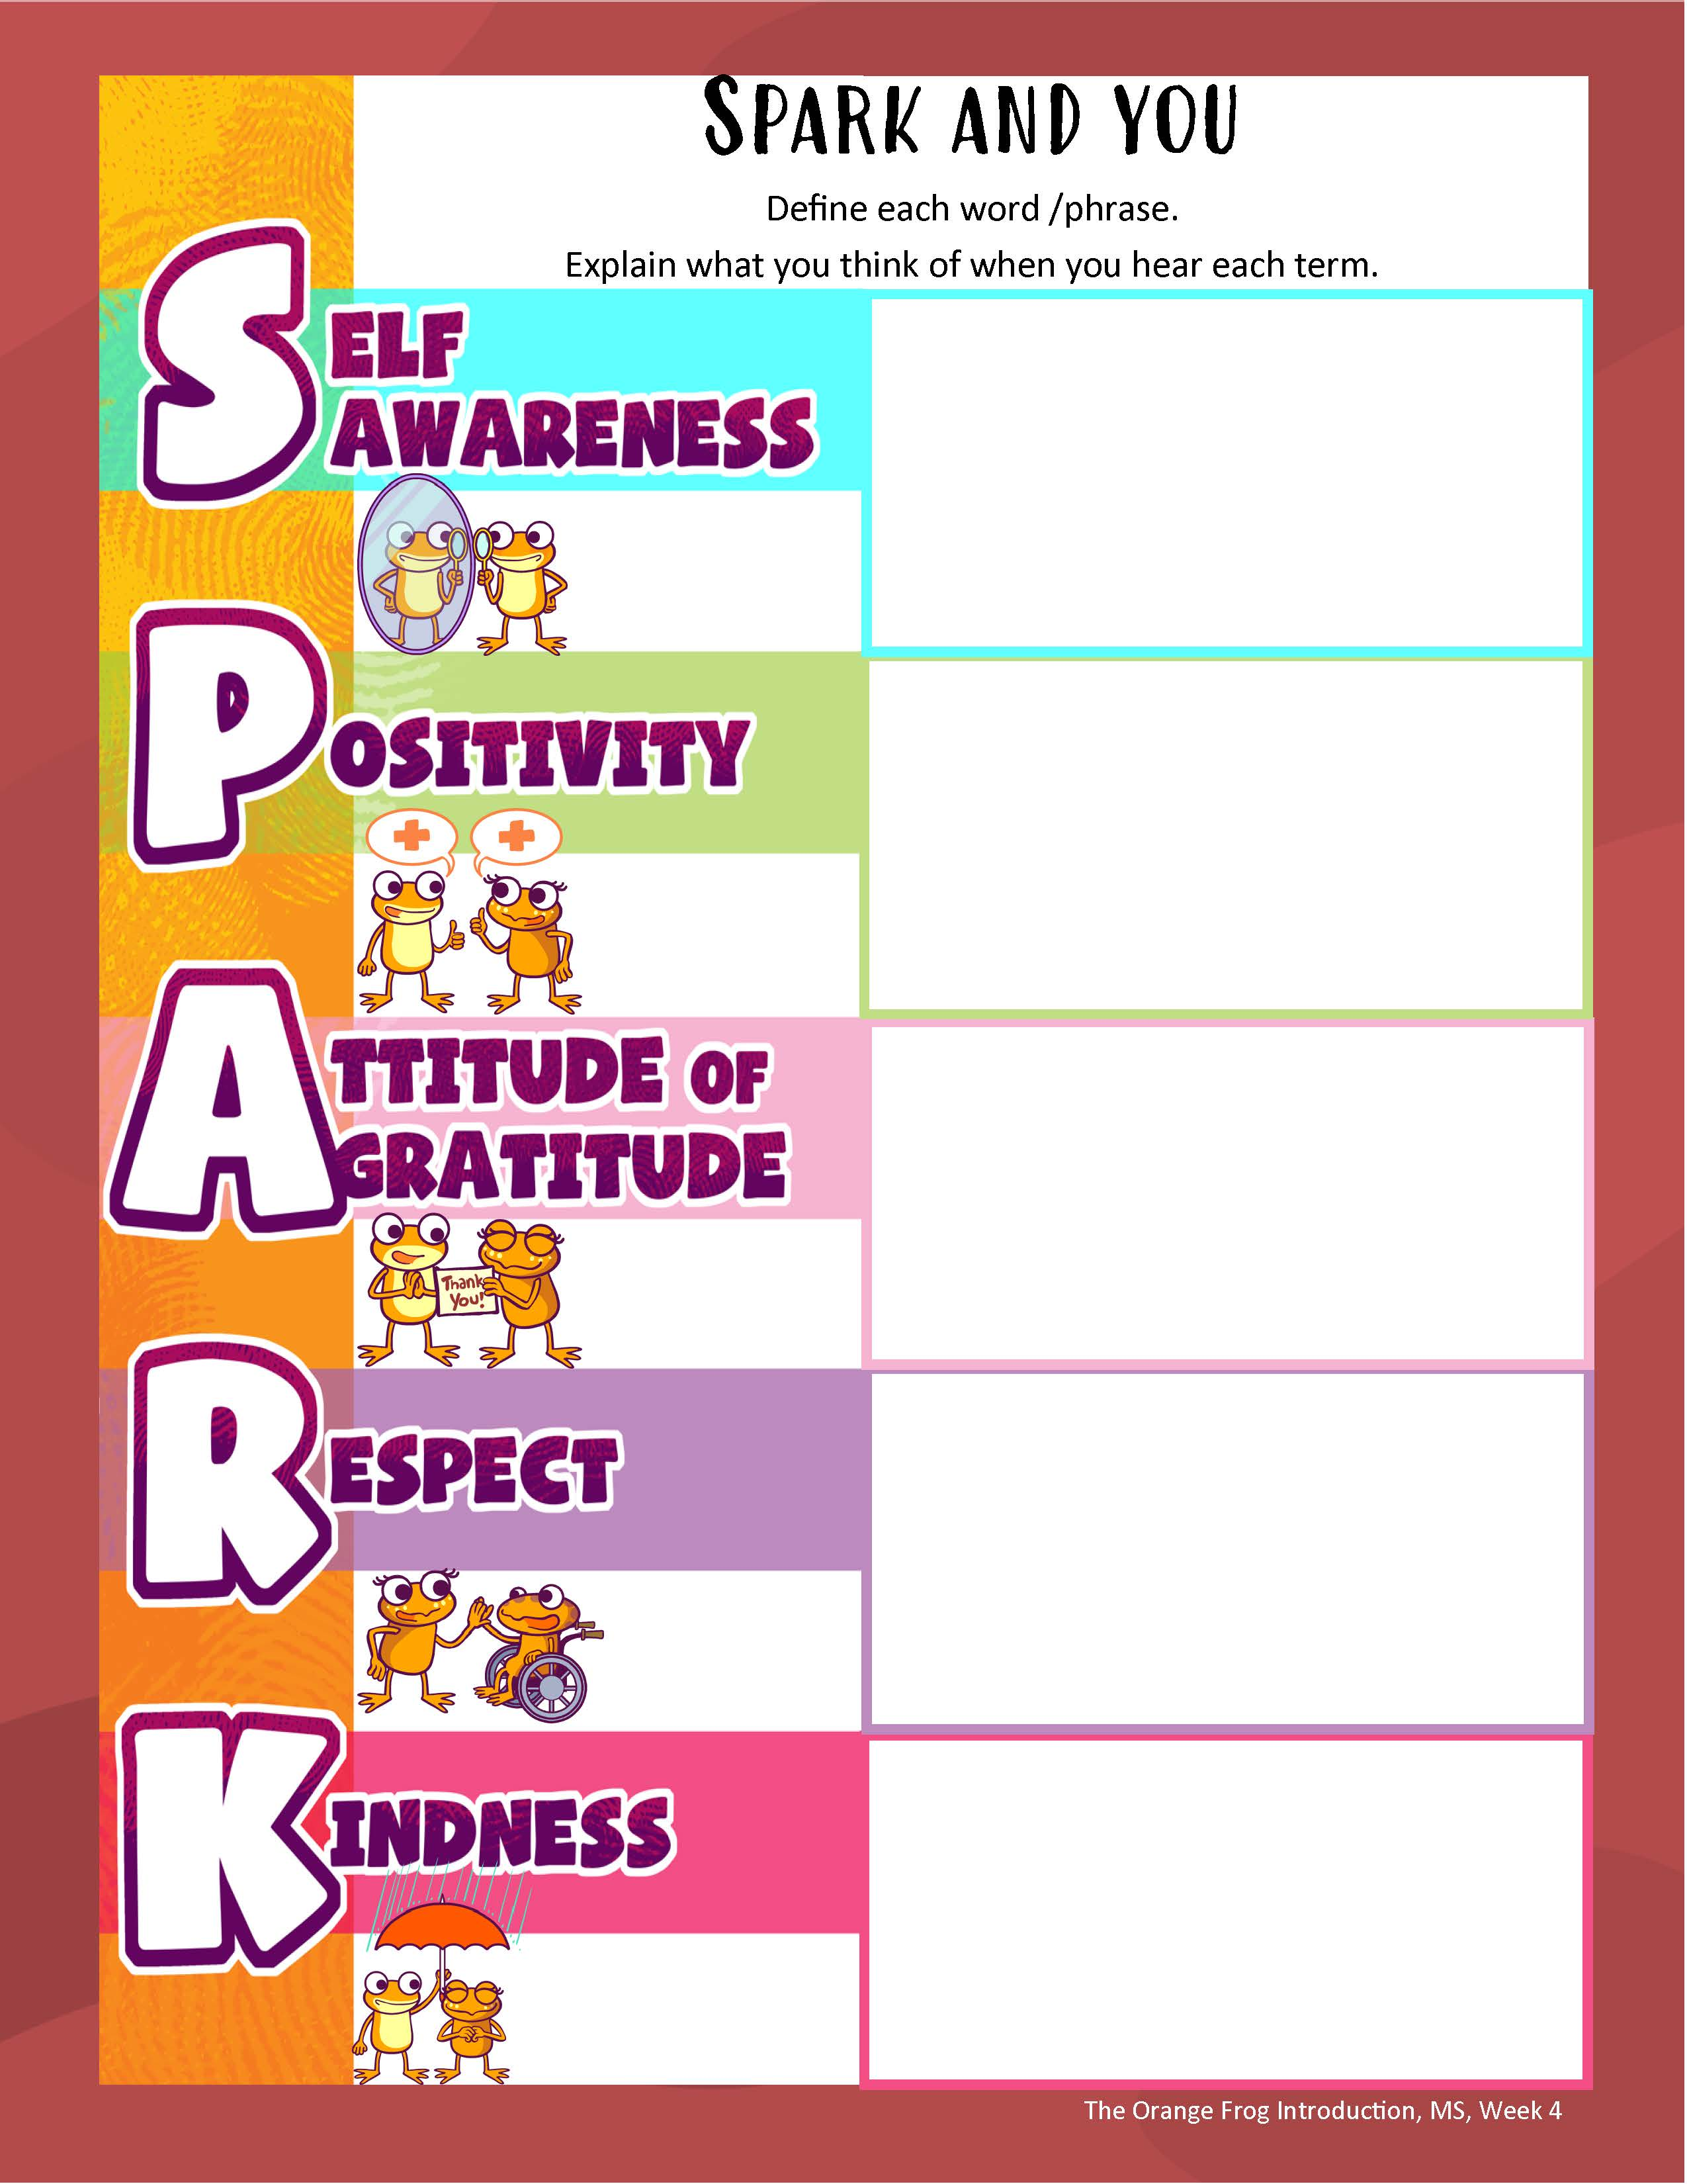
Action
We know that the frog that catapults this whole process into action was Spark. What if we started to think like Spark? What if we spent time emulating his behaviors? What would the look like?
We are going to look at an acronym for SPARK that will help us remember.
Notes:
Link to the SPARK Acronym document by clicking the image above.
Instructors: If you need examples for each letter of the acronym, please check page #3 of the Lesson Plan for a list.

Slide 9
Bonus Questions
Who was the main frog that remained green the longest?
What is a Thrall Frog? What is a real-world connection to the Thrall?
Who were the fastest frogs to adapt? Why?
What was the solution to the impending storm wipe out?

